Slide 1
Practice Questions for Bright and Weak Students

Slide 2
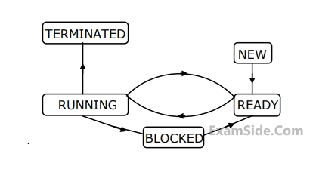
Practice Questions
The process state transition diagram in Figure is representative of
a) A batch OS
b) OS with preemptive scheduler
c) OS with non preemtive scheduler
Ans - OS with preemptive scheduler

Slide 3
Practice Questions
A context switch occurs when a state of process changes from new to ready
a) True
b) False
Ans - False

Slide 4
Practice Questions
An operating system with multiprogramming capability is one that___________
1) allows several users to use the same program at once by giving each a slice of time
2) loads several independent processes into memory and switches the CPU from one job
to another as required
3) runs programs over more than one processor
4) None of the above
Ans - 2

Slide 5
Practice Questions
Aging is a solution to the starvation problem
a) True
b) False
Ans - True

Slide 6
Practice Questions
Processes A,B,C,D have estimated burst times of 4,5,6,7 ns respectively.
They are scheduled in round robin fashion and the time slice is of 2ns.
The processes A,B,C,D arrive at the 0, 0.1, 0.2, 0.3 ns respectively.
At what time will the process A complete? __________
Ans - 10

Slide 7
Practice Questions
Processes A,B,C,D have estimated burst times of 4,5,6,7 ns respectively.
They are scheduled in round robin fashion and the time slice is of 2ns.
The processes A,B,C,D arrive at the 0, 0.1, 0.2, 0.3 ns respectively.
At what time will all the processes complete? __________
Ans - 22

Slide 8
Practice Questions
processes A,B,C,D have estimated time of completion of 5,7,9,11 ns each.
They are scheduled in round robin fashion and the time slice is of 2ns.
The processes A,B,C,D arrive at the 0,1,2,3 ns respectively.
At what time will the process C complete?
Ans - 29

Slide 9
Practice Questions
A Round Robin Scheduling algorithm with a large time slice will behave similar
to a First-Come-First-Serve algorithm.
True
False
Ans - True

Slide 10
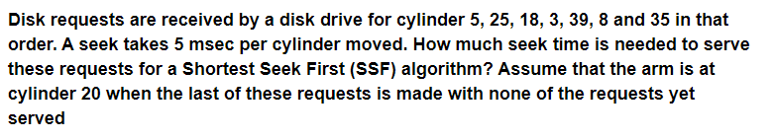
Practice Questions
Ans - 295 msec

Slide 11

Practice Questions
Ans - 256 MB, 19 bits

Slide 12
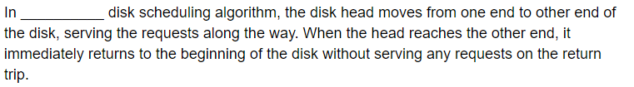
Practice Questions
Ans - CSCAN

Slide 13

Practice Questions
Ans - 7

Slide 14

Practice Questions
Ans - 160ns

Slide 15
Practice Questions
Ans - 21,17

Slide 16
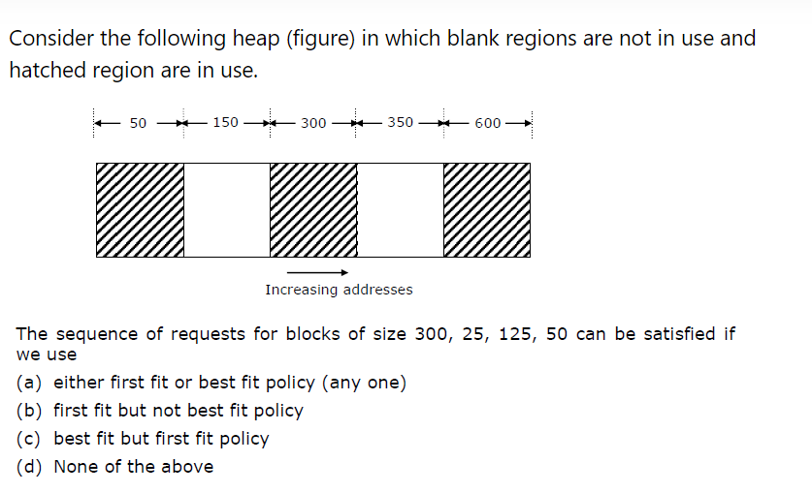
Practice Questions
Ans - B

Slide 17
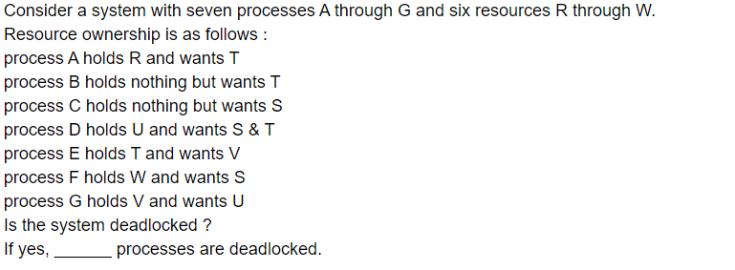
Practice Questions
Ans - Yes, D-E-G

Slide 18
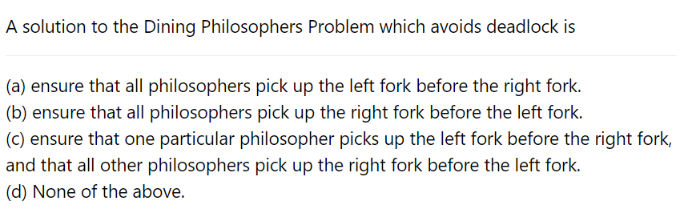
Practice Questions
Ans - C

Slide 19
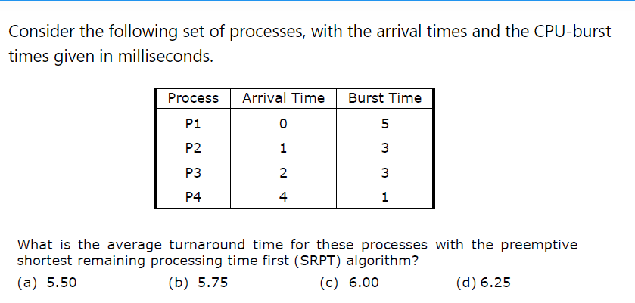
Practice Questions
Ans - A

Slide 20
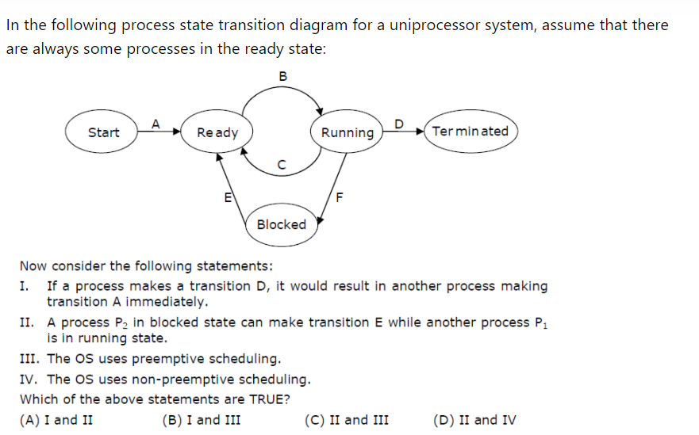
Practice Questions
Ans -C

